Slide 1





Enhancing Healthcare Administration: Implementing a Chatbot for Streamlined Insurance Claims and Patient Engagement
A
T
S
O
N
W
A
I

Slide 2

Introduction to
Healthcare Chatbots
In today's healthcare landscape, the integration of technology is crucial. This presentation explores the role of chatbots in enhancing insurance claims processing and improving patient engagement. We will discuss the beneﬁts, implementation strategies, and expected outcomes of using chatbots in healthcare administration.

Slide 3
Current Challenges in Healthcare
Healthcare administrators face numerous challenges, including ineffficient claims processing, long wait times, and poor patient communication. These issues lead to frustration for both patients and staff. Understanding these challenges is essential for developing effective solutions, such as chatbots.

Slide 4


What is a Chatbot?
A chatbot is an AI-driven tool designed to simulate conversation with users. In healthcare, chatbots can assist with claims inquiries, appointment scheduling, and answering patient questions. This technology enhances effficiency and improves the overall patient experience by providing timely information.

Slide 5


Beneffits of Chatbots in Healthcare
Implementing chatbots offers numerous beneffits, including 24/7 availability, reduced administrative workload, and improved accuracy in handling claims. By streamlining processes, chatbots can enhance patient satisfaction and allow healthcare providers to focus on critical tasks.

Slide 6
Implementation Strategies
Successful chatbot implementation requires a clear strategy. Key steps include identifying user needs, selecting the right technology, and ensuring integration with existing systems.
Continuous monitoring and feedback collection are essential for optimizing chatbot performance and user experience.

Slide 7
Case Studies of Successful Chatbot Use
Several healthcare organizations have successfully implemented chatbots, resulting in signifficant improvements in claims processing and patient engagement. Case studies highlight the effficiency gains, reduced costs, and enhanced patient experiences achieved through chatbot technology.

Slide 8
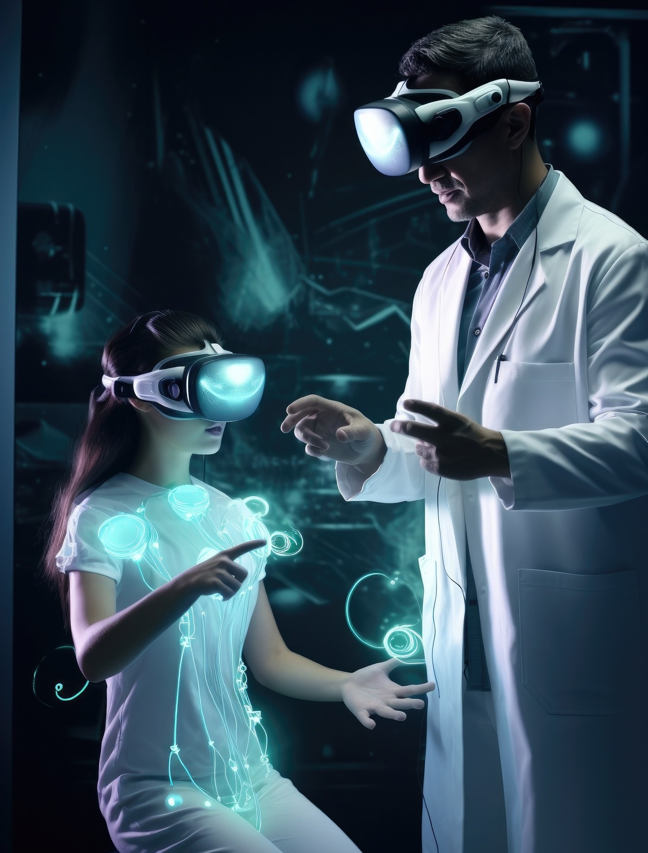
Future Trends in
Healthcare Technology
The future of healthcare technology is promising, with chatbots playing a pivotal role. Trends indicate an increase in AI integration, advanced natural language processing, and enhanced personalization. These developments will further transform patient interactions and streamline administrative tasks.

Slide 9

Conclusion
In conclusion, implementing a chatbot in healthcare administration can signiﬁcantly enhance effficiency and patient engagement. Organizations should evaluate their needs and consider adopting this technology to stay competitive. The next steps involve planning, development, and continuous improvement.

Slide 10

Thanks!

Slide 11

Any Doubts?

